Slide 1
Network-wide Consensus Utilizing the Capture Effect in Low-power Wireless Networks
Proceeding
SenSys '17 Proceedings of the 15th ACM Conference on Embedded Network Sensor Systems
Article No. 1
Zhenyang Chao
05/03/2018

Slide 2
Beshr Al Nahas -Chalmers University of Technology Gothenburg, Sweden
Simon Duquennoy
-RISE SICS, Sweden Inria Lille - Nord Europe, France
Olaf Landsiedel
-Chalmers University of Technology Gothenburg, Sweden

Slide 3
Outline
Introduction
A²: agreement in the air
Evaluation
Conclusion

Slide 4
Introduction
A²: Agreement in the Air
Based on Chaos
Basic concepts

Slide 5
Low-power wireless network
It is designed to allow long range communications at a low bit rate among things.
e.g. temperature sensors operated on a battery
cut down on overall power consumption
control the active time
varying the power setting modes of the devices

Slide 6
Capture effect
Capture effect is a phenomenon associated with FM reception in which only the stronger of two signals at, or near, the same frequency or channel will be demodulated.
Nodes overhearing the concurrent transmissions receive one of them with high probability, due to the capture effect.

Slide 7
Network-wide Consensus
Consensus is the problem of reaching agreement among several processes about a proposal, i.e., accept or decline it after a finite time of execution.
Networked cooperative robots
Wireless closed-loop control applications such as adaptive tunnel lighting
Industrial plants
...

Slide 8
Two simple consensus protocols
One static coordinator(leader) and a set of participants(cohort)
Two-phase commit(2PC)
(a) Proposal Voting
(b) Decide
simple, low complexity
limitation of being blocking
Three-phase commit(3PC)
(a) Proposal Voting
(b) Pre-Commit (or abort)
(c) Do Commit
non-blocking
unable to maintain consistency

Slide 9
A²: agreement in the air
A set of network-wide communication primitives
Voting
2PC
3PC
Multi-phase
Join/Leave

Slide 10
^{SYNCHROTRON}
the synchronous transmission kernel
Slot
the minimum time unit, which fits one packet transmission or reception and processing, including packet handling by the application, authentication, en- and decryption, etc.
Round
grouped slots
VHT
virtual high-definition timer
maintains synchronization in A² network

Slide 11
^{Parallel Channels}
Multiple channels in parallel are used In A². Each node randomly chooses one channel per time-slot to either receive or transmit.
reduces network density and thereby increase the probability of capture
reduces network diameter
but increases frequency diversity...

Slide 12
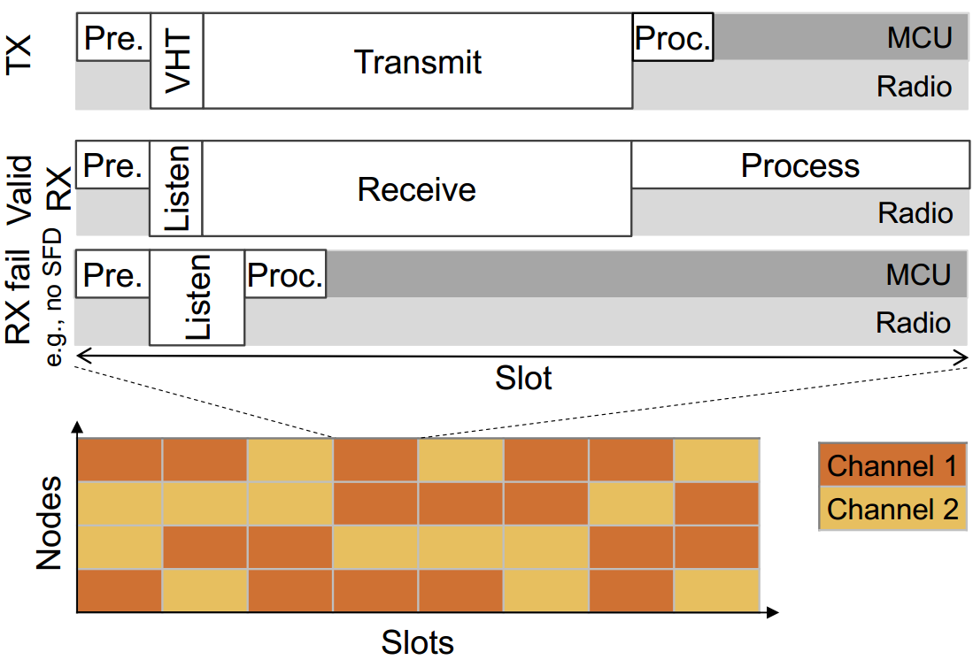

Slide 13
Voting Primitive
Nodes share two pieces of information in each transmission:
(a) The proposed value the nodes are voting on
(b) a list of votes representing for each node whether it already voted and whether the vote was for or against the proposal.
collects votes from all participants for or against a proposed value
the coordinating node is aware of which nodes voted for and against the proposal
so do other nodes

Slide 14
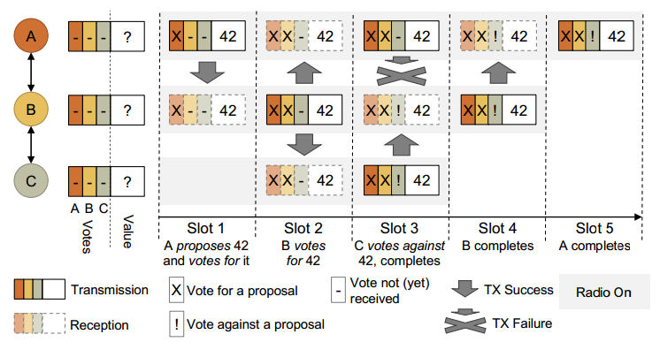
Voting round

Slide 15
2PC in A²
handles node failures
a recovery mechanism
no further commit can complete until all blocked nodes are recovered

Slide 16
3PC in A²
There is a buffer state, pre-commit, between the voting and the commit phases, ensuring that no node commits while any other node is still uncertain.
Proposal Voting Phase
Pre-commit or Abort Phase
Do Commit Phase

Slide 17
A² Services
Join/leave
Sequence Numbers
...

Slide 18
Join Request
Packet header
including low-level parameters such as length of the round, slot size, packet size, and when the next round is scheduled and its application type
New nodes
set a single bit join flag – in the packet header
Other nodes receiving this flag also set it in all subsequent transmissions.This flag will eventually propagate in the network and reach the coordinator, which will schedule a join round.

Slide 19
^{Leave}
If a node does not participate for a number of rounds, the coordinator distributes new flag assignments that remove the node from the list of participants.
Leave can optionally employ 2PC/3PC.

Slide 20
^{Sequence Numbers}
assign each configuration(node list) a sequence number, increased whenever nodes are added or removed
ensure consistency

Slide 21
Evaluation
Testbed | Nodes # | Coordin-ator ID | Density # | Diam. [Hops] | Channel # | Tx Power [dBm] | Flags [Bytes]
Euratech | 213 | 3 | 106 | 2 | 15 | 0 | 27
Rennes | 190 | 3 | 90 | 2 | 15 | 0 | 23
Indriya | 97 | 35 | 32 | 3 | 2 | 0 | 13
Flocklab | 29 | 3 | 7 | 4 | 2 | 0 | 4

Slide 22
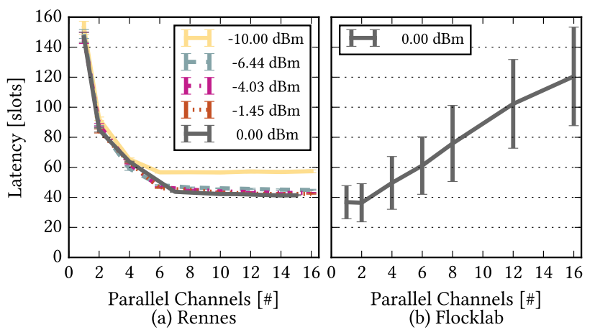
Multiple channels

Slide 23
Long-term performance
more than 21000 rounds for each testbed
average radio-on time for one round: 137–165 ms

Slide 24
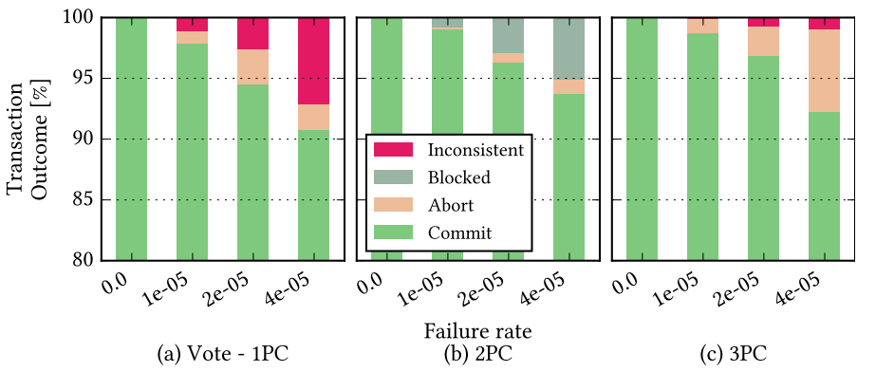
Consistency of Consensus
Vote has a low cost but suffers from inconsistencies, 2PC solves inconsistencies with blocking, 3PC trades consistency for liveness and maximizes the ratio of successful (live and consistent) transactions.

Slide 25
Conclution
low-latency
reliable consensus
low loss rate

Slide 26
Thank you!
E-mail: zhchao@ucsc.edu

