Slide 1
Network Measurement in Multihop Wireless Networks with Lossy and Correlated Links
Yuchen Yuan
May 3rd, 2018

Slide 2
Outline
Introduction & Related Work
Motivation
NetVision
Evaluation

Slide 3
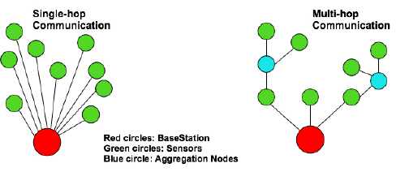
Multihop Networking
Multihop V.S. Singlehop
Notes:
a hop is one portion of the path between source and destination. Data packets pass through bridges, routers and gateways as they travel between source and destination. Each time packets are passed to the next network device, a hop occurs
Short transmission range in Singlehop network prevents the use cases of IoT applications from running over a large number of devices.

Slide 4
Related Work
IETF RoLL proposed RPL - multihop routing protocol built on IPv6 for low-power and lossy networks.
WirelessHART -multihop routing protocol with real-time and high-reliability guarantees.
Bluetooth SIG released Bluetooth 5.0 with multihop mesh networking capabilities.
Multihop
Notes:
RPL which is a multihop routing protocol built on IPv6 for low-power and lossy networks monitoring all communication links cannot provide a guarantee on the packet capture ratio

Slide 5
Measurements
In-band measurement - collect the measurement data on the same communication channel for data packets, in-band approaches are vulnerable to possible packet losses.
Out-of-band measurement - use external sniffers to monitor the network traffic passively. Compared with in-band approaches, they can provide more detailed information about the network
Notes:
multihop wireless networks, measurement has become fundamental to network operations including manage-ment, security, diagnostics, optimization or simply enhancing our collective understanding of the network as a complex system.
They can be broadly classified into two categories: in-band and out-of-band.
In band 容易受攻击 they are limited to observe network states only at the base station
Previous works have demonstrated that out-of-band approaches are indeed useful for analyzing sensor network behaviors

Slide 6
Out-of-band Measurement
Packet Capture Ratio(PCR) for each node : the ratio of packets captured (received) by the sniffers among all packets transmitted.
Packet capture ratio directly relates to measurement quality.
There is always a tradeoff between the number of deployed sniffers (deployment cost) and the packet capture ratio (measurement quality)
Notes:
PCR 与网络的连接质量有直接关系，as more packets are captured, more accurate measurement results can be achieved.
很多的测量不能在low PCR 的情况下实现
It is well-known that packet routing
behaviors change often due to the dynamic forwarding policies
or topology changes in multihop wireless networks

Slide 7
Related Work
SMSN selects sensor nodes from the network and activates sleeping nodes as monitors.
DMWSN deploys external sniffers at arbitrary locations to ensure that every communication link is monitored.
Sniffer Deployment
Notes:
SMSN It aims at finding an optimal set of monitors to monitor every communication link
Later I’ll show the comparison for the system this paper proposed and these two technique

Slide 8
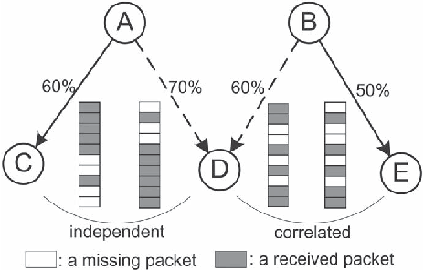
Motivation
Existing approaches are unsuitable for multihop wireless networks with lossy and correlated links which is shown by recent studies.
Notes:
• CTI (Cross-Technology Interference): Multiple wireless technologies used today share unlicensed band. For instance 802.11b/g/n and 802.15.4, all reside on the 2.4 GHz ISM band
especially for networks operating in the 2.4GHz bands (e.g., ZigBeeand Bluetooth) which could be severely interfered by other wireless technologies (e.g., WiFi)

Slide 9
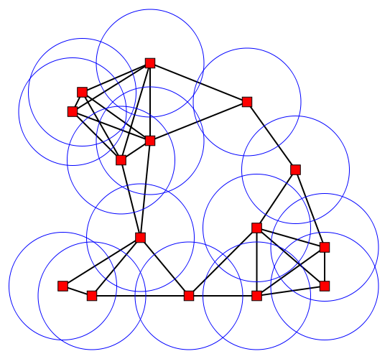
Motivation
Most existing approaches are based on the too ideal unit disk graph (UDG) model.
Notes:
a sniffer can capture most of the packets sent by nodes located in the circular communication region centered at the sniffer. They cannot accurately quantify
the amount of packets captured by the sniffers since the communication range is irregular and the packet capture is probabilistic in practice.

Slide 10
NetVision
A practical network measurement system with special considerations for sniffer deployment.
NetVision can accurately quantify the packet capture ratio of each node for a given sniffer deployment.
Formulated the sniffer deployment problem as an optimization problem and proposed efficient heuristic algorithms for this problem.
NetVision provides a set of instructions and APIs to simplify a variety of measurement tasks.
Notes:
转化成一个 优化问题 to minimize the number of sniffers while the packet capture ratio for each node is satisfied

Slide 11
NetVision-Advantages
Deployment efficiency
While the packet capture ratio for each node satisfying, NetVision should minimize the number of sniffers.
NetVision deploys sniffers at node positions in the network without assuming the UDG model.
Ease of measurement
NetVision makes measurement programming easier by carefully designing a set of simple instructions and APIs.

Slide 12
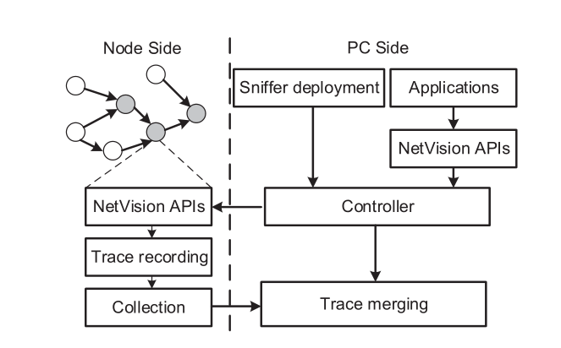
NetVision Architecture
Notes:
NetVision aims to provide a practical and generic network measurement system

Slide 13
NetVision-PC side
Selects positions to place sniffers to minimize deployment cost and satisfymonitoring requirements
NetVision APIs on the sniffer allow the user to specify the type of packets they want to monitor.
Trace merging component merges multiple sniffer traces with the correct transmission information and synchronized timestamps.

Slide 14
NetVision-Sniffer Deployment
Assumption : assume that sniffers are deployed at the positions of network nodes. This assumption also allows us to use the network nodes as sniffers directly.
Definition1 (Packet Capture Ratio): PCR of a node is the percentage of its packets observed by sniffers in S. These packets are either originated or forwarded by the node.
Definition2 (Minimum-κ-covered): A node is minimum-κ-covered if the packet capture ratio of the node is no less than a specified threshold κ. The network is minimum-κ-covered if all nodes are minimum-κ-covered.
Notes:
In addition, deploying sniffers at node positions is more practical since not all positions are geographically reachable.

Slide 15
NetVision-Sniffer Deployment
Aim at deploying a set of sniffers that:
the number of sniffers is minimized (2)the network is minimum-κ-covered
Sniffer Deployment
Link-quality-aware sniffer deployment(assume the links are independent , quality of each link is known)
Link-correlation-aware sniffer deployment(assume that the links are correlated, link correlations can be obtained)

Slide 16
Set κ=0.8
Under link correlation model.
For sniffer sets of size 2, the node PCR of v with sniffer set $\left\{s_{i},s_{j}\right\}$is 1−Pr(E v,s i ,E v,s j ).
With sniffer set {$s_{1}$, $s_{2}$ }, Pr(E v,s 1 ,E v,s 2 ) equals 0.3 from the packet reception trace. Therefore, the PCR of v is 0.7.
Similarly, the PCR of v with $\left\{s_{2},s_{3}\right\}$and {s 1 ,s 3 } are 0.8.
Under link independence model.
The PCR of v with sniffer set $\left\{s_{i},s_{j}\right\}$ is the probability that at least one of them observes the packet.
With sniffer set {$s_{1}$, $s_{2}$ }, PCR of v is 1−(1−0.5)∗ (1−0.6) = 0.8 .
PCR of v with set $\left\{s_{2},s_{3}\right\}=0.76$ , with set$\left\{s_{1},s_{3}\right\}=0.7$
Notes:
Fig. 2 shows an illustrative example of sniffer deployment under different link models. The goal is to select a minimum number of sniffer nodes from s 1 ,s 2 ,s 3 to make v minimum-κ-covered.
Suppose E v,s i is the event that a packet is successfully observed by si The packet delivery ratio p v,s i of each link (v,s i ) is given in the figure.
According to the link quality, none of the three sniffers can make v minimum-κ-covered Let us consider sniffer sets of size 2.
As a result, s 1 and s2 are selected to be sniffer nodes.
This example demonstrates the difference of sniffer deployment under different link models. We can see that the link independence assumption sometimes overestimates the node PCR when links are correlated. In this example, the real node PCR is 0.7 with {s 1 ,s 2 }.

Slide 17
Link-Quality-Aware Sniffer Deployment
In the link independence model, the packet missed by a sniffer has no relationship with the packet missed by other sniffers. Then, the PCR of node v
$S_{v}$ denotes set of sniffers deployed in node v’s neighborhood
$p_{v,si}$ denotes packet delivery ratio from node v to sniffer $s_{i}∈S_{v}$
To make sure PCR is no less than k, which is $C\left(v\right)≥k$, and packet delivery ratio $q_{u,v}$ of each link $\left(u,v\right)∈E$ , $x_{i}$be the binary indicator of whether the $i^{th}$ node is selected as a sniffer node
$$x_{i}=\left\{\begin{aligned} 1, v_{i} is selected \\ 0, else\end{aligned}\right.$$
C$\left(v\right)=1−\prod_{s_{i}∈S_{v}}{(1−p_{v,si})}$
Notes:
if sniffers are deployed at s 1 and s 2 , the
PCR of v is 1−(1− p v,s 1 )∗(1− p v,s 2 ) = 1−0.5∗0.4 = 0.8.

Slide 18
Link-Quality-Aware Sniffer Deployment
To find min $\sum_{1≤i≤n}{x_{i}}$ S.t
For $x_{i}=0 or x_{i}=1$
Our goal is to find the values of $x_{i}$ to minimize the number
of sniffers.
$$1−\prod_{i=0}^{n}{(1−p_{i,v}×x_{i})≥k}$$
Notes:
The constraint is that for any node v, it is minimum κ covered.

Slide 19
Link-correlation-aware sniffer deployment
This model’s difference is the computation of node PCR. The probability that at least one sniffer in $S_{v}$ receives the packet from v is calculated as:
$C\left(v\right)=\sum_{k=1}^{|S_{v}|}{{(−1)}^{k−1}Pr⁡(s^{k})}$
$S_{v}$ is any sniffer set with size k ( among total ${|S|}_{v}$ sniffers )
$Pr⁡(s^{k})$ is probability that any k of the ${|S|}_{v}$ sniffers successfully receive a packet
$\operatorname{Pr}\left(s^{k}\right)=\sum_{s^{k}∈S_{v}}{Pr⁡(E_{v,s_{1}^{k}}…..E_{v,s_{k}^{k}})}$
$E_{v,s_{i} }$ is the event that a packet is successfully received by sniffer $s_{i}$, and $Pr⁡(E_{v,s_{1} },E_{v,s_{2} }$) is the probability that both s1 and s2 received the packet, which can be get from packet reception traces as shown in Fig. 2. The “0” indicates a packet loss and “1” indicates a packet reception

Slide 20
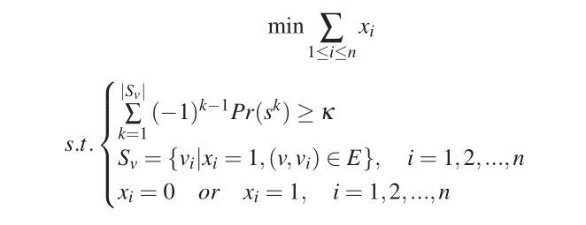
Link-correlation-aware sniffer deployment
Given the input routing topology G = (V,E) with n nodes, the PCR threshold κ, and the packet delivery ratio $q_{u,v}$ of each link (u,v) ∈ E, the link correlation information among links, this problem could be

Slide 21
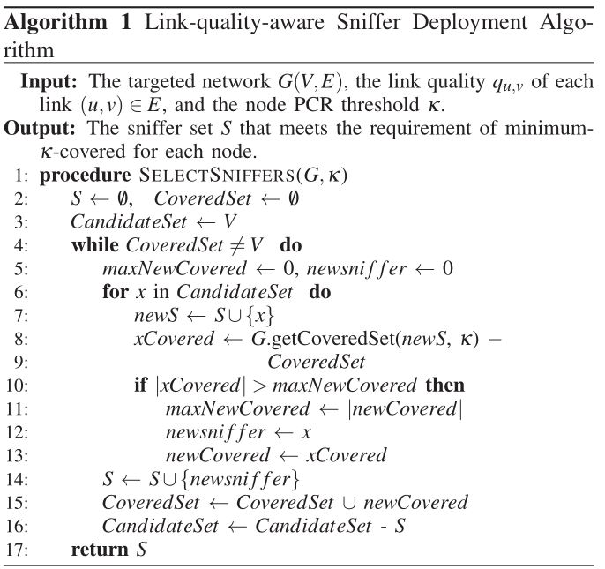
Algorithm Design
Notes:
多种角度去解释这个kernel 结果

Slide 22
Practical Issue For Implementation
Knowledge of link quality and link correlation
NetVision needs the help of in-band techniques to obtain the link qualities and link correlations
Practical sniffer deployment.
the sniffer can be deployed as software. For example, the node can enable the promiscuous mode to monitor the traffic of its neighbors without affecting its regular data traffic. The second way is to deploy external nodes as sniffers
Trace recording
NetVision collects packet transmission information from its header at each hop and the arrival time. To further reduce the trace size, NetVision enables the user to specify packet types of interest
Trace collection
A simple way of retrieving traces is via the serial connection. However, it is only possible in an indoor testbed. In outdoor deployment, most sniffers may not be easily accessible.
Trace inference.

Slide 23
Applications-NetVision Instructions
The final goal is to facilitate easy measurement. NetVision provides simple instructions that can support various measurement or debugging applications.
TRACE,
CFIND,
CEXEC

Slide 24
Measurement Applications
Hotspots analysis
Consider the demand of monitoring node hotspots within the network which is a basic need for network monitoring. Hotspots can cause congestions or packet losses. Thus, it is important to localize hotspots for network monitoring or diagnose
NetVision can provide fine-grained per-packet per-hoptransmission visibility inside the network. With a merged fine-grained trace, we can find nodeIDs which appear more than the threshold (e.g., 2000) in a given time range (i.e., tRange).
Notes:
A hotspot is a node that appears to be the source of, or destination of, more packets than others.

Slide 25
Measurement Applications
Link loss ratio measurement
A wireless link is usually characterized by its loss ratio
Existing works usually infer the link loss ratio based on network tomography approaches which target at static or slowly changing routing paths and are not suitable for dynamic wireless networks
NetVision can measure the link loss ratio accurately based on the actual packet transmissions even in poor network condition

Slide 26
Measurement Applications
Packet loss localization
Using NetVision, we can observe the packet transmissions from multiple vantage points in the network and reconstruct the trajectory of each packet.
Notes:
The following example shows how to localize the packet loss

Slide 27
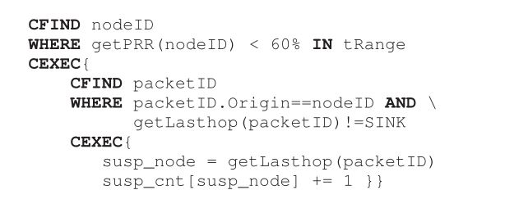
Notes:
It first finds out lossy nodes whose packet reception rate is lower than a threshold (e.g., 60%). Then, missing packets originated from lossy nodes can be obtained as follows. For each missing packet, we regard the last hop on its path as the suspicious location and count the number of missing packets at each suspicious location. Finally, the result is a count table where each entry denotes the node that has missing packets.

Slide 28
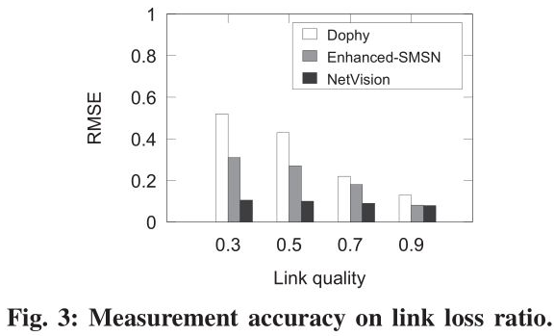
Evaluation
simulated 225-node network
compare the measurement accuracy in terms of RMSE
Notes:
The sniffer deployment
strategy we employ here is link-correlation-aware-sniffer-
deployment. For comparison, we also evaluate the accuracy
of a typical in-band technology Dophy [24] and an out-band
technology SMSN [14]. Dophy is the state-of-art in-band work
on link loss ratio measurement in WSN. It encodes the number
of retransmissions at each hop into the packet and recovers
them at the sink for link loss ratio estimation. SMSN is a
typical sniffer deployment strategy, and we extend it with our
trace merging scheme to perform loss rate measurement. We
refer to it as Enhanced-SMSN

Slide 29
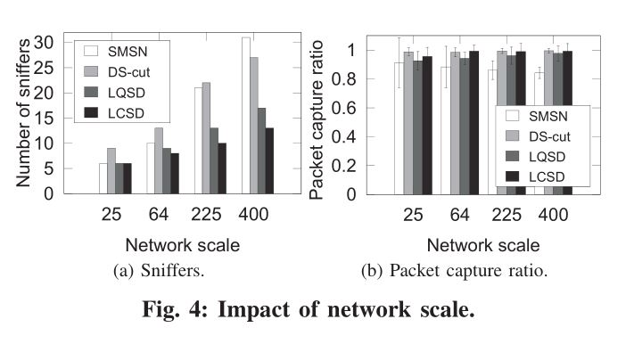
Notes:
Top left is soprts cars. Ordinary cars middle right .Sport utility vehicles bottom left
Also sport utility vehicles from German manufacturers are placed next each other.?

Slide 30
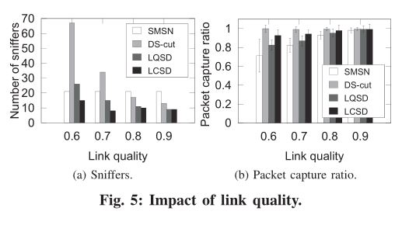
Using Netvision to compare different multihops protocol

Slide 31
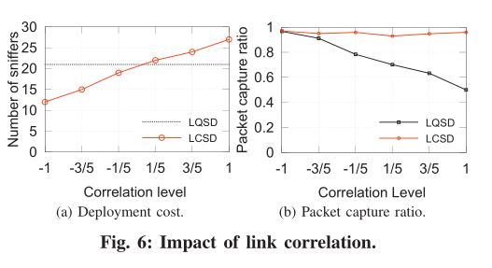

Slide 32
Conclusion
First to formally consider the sniffer deployment problem in multihop wireless networks with lossy and correlated links.
Quantify the measurement quality using a metric called packet capture ratio. Based on this metric, we formulate the sniffer deployment problem as an optimization problem and propose efficient heuristic algorithms to address it.
Designing and implementing NetVision, a practical net-work measurement system in TinyOS/TelosB platform. NetVision exposes a set of APIs to facilitate a varietyof measurement tasks. Applying NetVision in three case studies demonstrates its benefits over existing in-bandmeasurement approaches.

