Slide 1
QuickTalk: An Association-Free Communication Method for IoT Devices in Proximity
Authors: Seongmin Ham, Jihyung Lee, Kyunghan Lee
School of ECE, UNIST
Presented by Andrea David

Slide 2
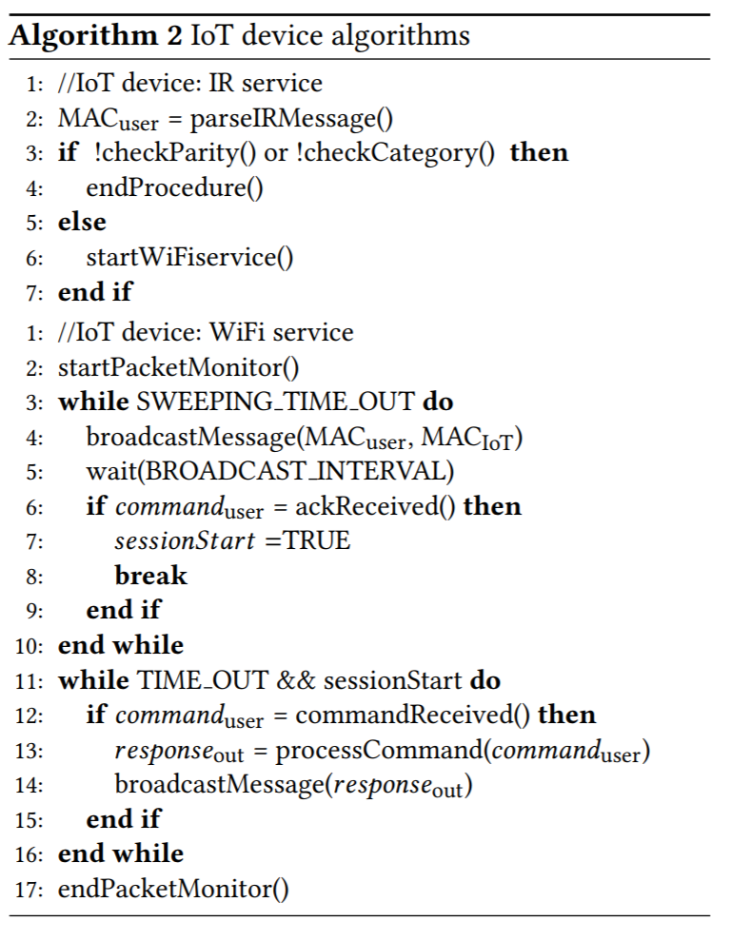
IoT Device Implementation
Data processing service
IR and WiFi sensors

Slide 3
Overview
Introduction
Related Work
System Design
Proposed Methods
Implementation
Evaluation
Conclusion

Slide 4
Introduction
IoT devices are generally straightforward to use
There are some cases where usability is poor
Visitor problem
Alice visits her parent’s house and can’t change the settings on the IoT thermal controller
Naming problem
Bob wants to individually configure the many window shades in his office
Range problem
Charlie wants to publicize information to the passing-by users
Solution: QuickTalk

Slide 5
QuickTalk
Association-free communication
Combines IR signal emission and WiFi overhearing
User device uses IR to pinpoint and ask the device for its ID
e.g., WiFi MAC address
How to pinpoint a device in proximity?
How to set up a communication channel without an association process?

Slide 6
Related Work
Network Architecture
Control Interface

Slide 7
System Design
Problem Statement
Users who don’t have permission can control the device
Authorizing individual visitors is not secure
Invalidating authorization is complicated
Hard to identify which control interface corresponds to which IoT device
Solution
Physically pinpoint an IoT device
Control it at any direction

Slide 8
Pinpointing
Candidates:
IR, QR code, RFID, NFC, audio signal, and image processing
Requirements
Few meters to tens of meters distance
Minimal effort
Maximum accuracy

Slide 9
QuickTalk Architecture
Two services
IR pinpointing
WiFi service for communication
User Device
IoT Device

Slide 10
QuickTalk Workflow

Slide 11
Challenges
Pinpointing ability of IR signal in real IoT environments
Reachable distance
Angle for pinpointing
Information bits (length, type, channel coding)
Implementation of WiFi communication
Association-free WiFi comuncation
No authentication
Security protection?

Slide 12
Proposed Methods (IR Pinpointing)
Identify IoT device to control
Trigger WiFi interface for communication

Slide 14
Proposed Methods (WiFi Communication)
Fake power save poll (802.11 standard)
Packet broadcast, monitoring

Slide 15
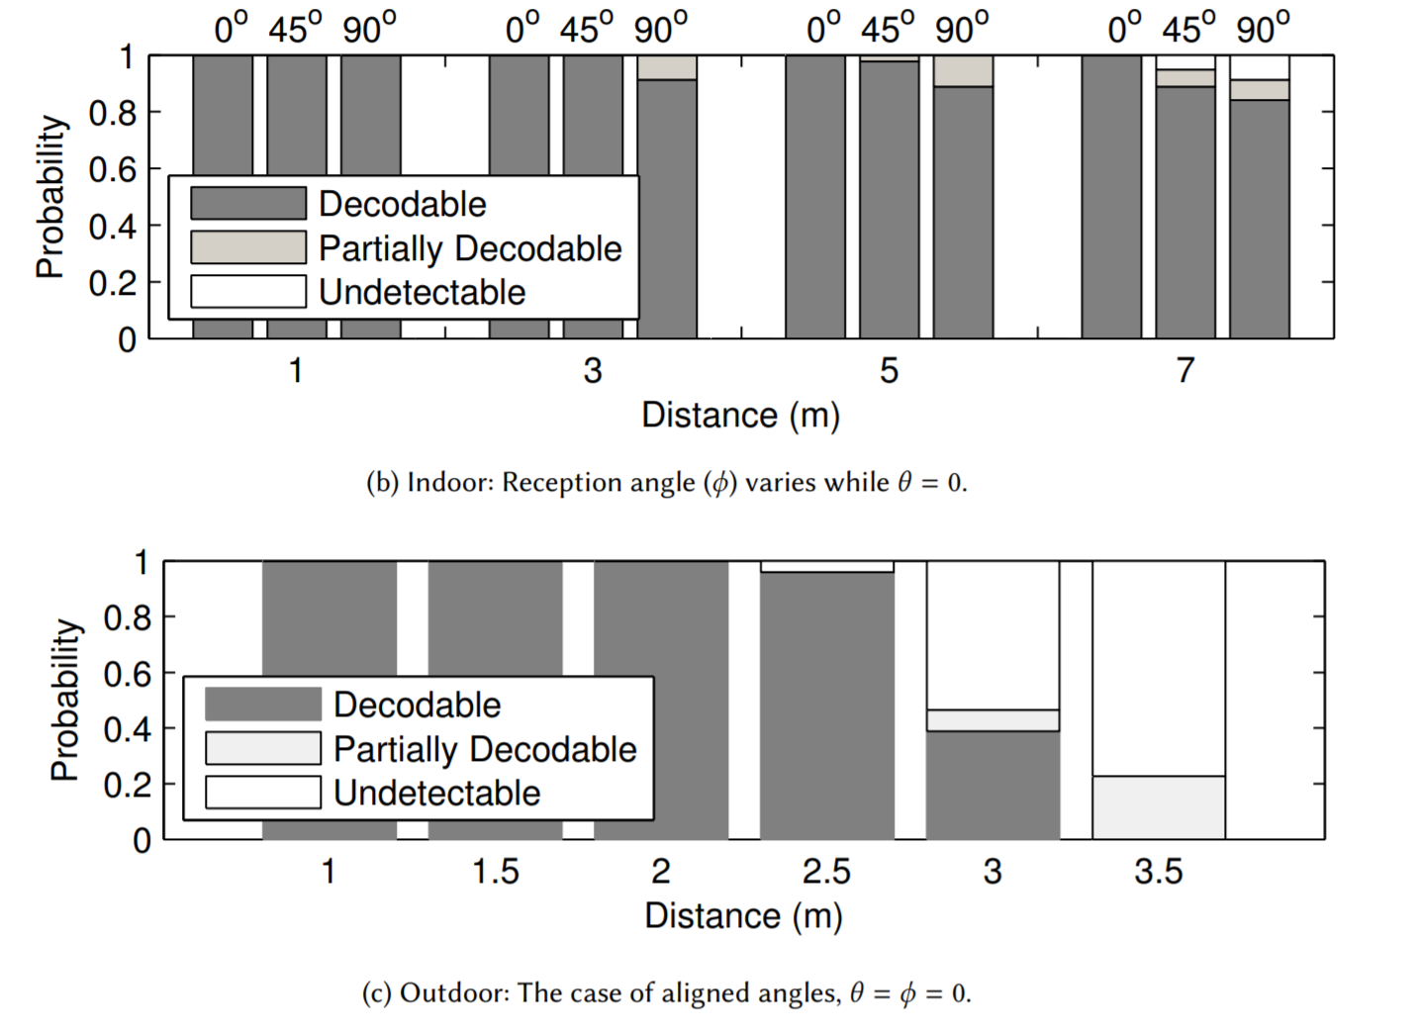

Slide 16
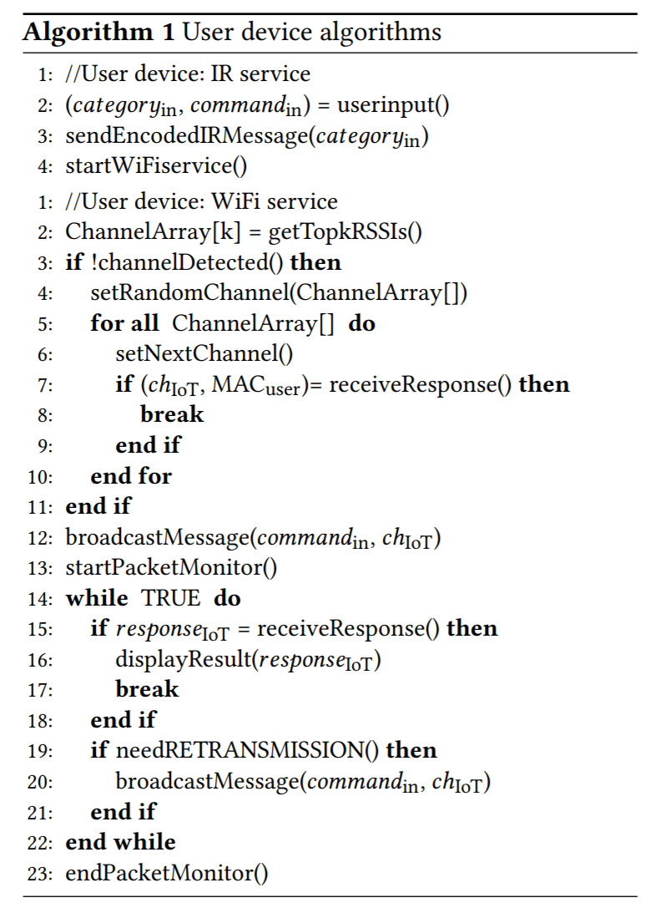
User Device Implementation
User interface
IR and WiFi Services

Slide 17
Security Implementation
IR signal emits encryption key from user device
IoT device authenticates key and ID
Elliptic Curve Menezes-Vanstone

Slide 18
Evaluation

Slide 19
End-to-end Delay

Slide 21
Coexistence with Ongoing Sessions

Slide 22
Conclusion
Visitor, naming, distance problem
Intuitive
Pinpointed communications for IoT devices

