Slide 1
STAPLE
Stateful Inter-Packet Signal Processing for Wireless Networking

Slide 2
Contributors
Shangqing Zhao
Zhengping Luo
Zhuo Lu
Xiang Lu
Yao Liu
University of South Florida, Tampa
Institute of Information Engineering
Chinese Academy of Sciences
University of CAS, Beijing
http://csa.eng.usf.edu/getsrc/?n=papers/17zll-mobicom.pdf

Slide 3
Overview
Introduction to STAPLE
Packet Reception in Wireless Systems
Signal Processing
Signal Decoding
Issues
STAPLE Architecture
Experimental Evaluation

Slide 4
What is STAPLE?
STAteful inter-Packet signaL procEssing
Wireless packet recovery system residing between physical and link layers
Focuses on repairing decoding errors in PHY and MAC headers
Experimentally shown to improve packet delivery by up to 20.8%
Standard independent
Can be implemented alongside standard packet reception system non-intrusively

Slide 5
Why STAPLE?
Wireless communication is complex and signal processing is challenging
Decoding errors are common
Without packet recovery, error packets are dropped

Slide 6
Packet Reception in Wireless Systems
Packet reception occurs at the Physical Layer
Signal Processing
Signal Decoding

Slide 7
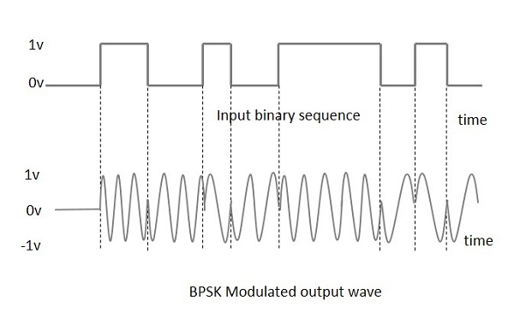
Packet Reception: BPSK
Credit: All About Circuits

Slide 8
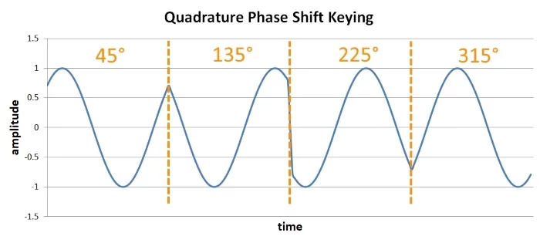
Packet Reception: QPSK
Credit: All About Circuits

Slide 9
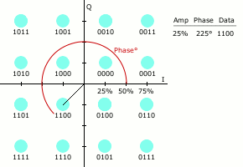
Packet Reception: 16QAM
Credit: Wikipedia

Slide 10
Packet Reception: Basic Structure

Slide 11
Packet Reception: Signal Processing
Receiver turned on when energy is detected
Signal is read in and stored as a vector of physical symbols
s = [s₁, s₂, …, s_{n}]
Channel and frequency offset are estimated and signal is compensated
s’ = [s’₁, s’₂, …, s_{n}]

Slide 12
Packet Reception: Signal Decoding
Decodes s’ into a bitstream
PHY header is demodulated and decoded first
PHY header contains modulation and data-rate information for the PHY payload
Upon success, PHY payload is processed by link layer and passed to upper layers

Slide 13
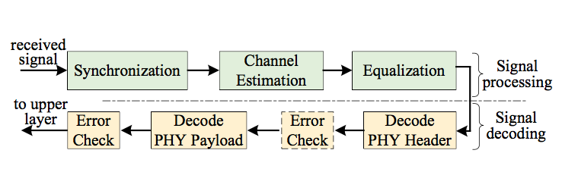
Packet Reception in Wireless Systems

Slide 14
Issues with Packet Reception
Reception and decoding of packets is complex due to estimation of channel and frequency offset, sometimes resulting in errors
Errors in decoding PHY header result in errors in decoding entire packet, results in dropping the packet
PHY header holds information necessary for demodulation and decoding of entire packet

Slide 15
The Idea Behind STAPLE
In practical application, PHY and MAC header fields exhibit low entropy
Example: A station in a WiFi connection mostly receives packets from a particular AP, exhibiting high commonality in PHY and MAC headers
Low entropy fields can be cached when successfully decoded in order to recover from signal decoding errors

Slide 16
Introducing STAPLE
Definition: The state of a packet is a bit sequence concatenated by one or more bit strings in the PHY and MAC header fields in the packet.

Slide 17
Introducing STAPLE
When a packet is received, it goes through signal processing and decoding. PHY payload is passed to upper layers if no error occurs (no recovery required)
If a PHY or MAC decoding error occurs, recovery is attempted by reassociating damaged packet with a previously stored state

Slide 18
Digging Deeper: STAPLE Architecture
State Table
State Association
Signal Re-processing

Slide 19
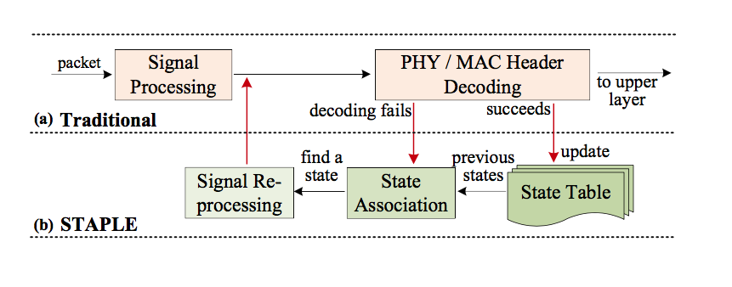
Architecture: Overview

Slide 20
Architecture: State Table
STAPLE state table is a table that holds the states of previous signals which were correctly decoded
Table size is variable and to be decided by engineer implementing STAPLE
Two management policies:
Timestamp policy
Upon successful decode, entry’s timestamp is updated if present in table. Otherwise oldest state is replaced
Frequency policy
Each state is stored with timestamp and usage count
Upon successful decode, entry’s timestamp is updated and usage count incremented.
If not present in table, entry with lowest usage count is overwritten. Oldest state with lowest count is used if multiple entries have the same lowest count.

Slide 21
Architecture: State Table
Notes:
Downlink performance may exhibit little effect if the table is small
Station always receives packets from the AP
AP receives packets from many stations
AP should have a larger table size than a station

Slide 22
Architecture: State Association
State association is attempted when PHY and MAC header decoding fails
Current packet state is compared with entries in state table
If Hamming distance is below a threshold value, association succeeds and state of broken packet is replaced with table entry
Hamming distance: number of bit differences between two bit sequences
If Hamming distance is greater than threshold, association fails and the packet is dropped
Given corrupted packet P with state S(P), associated state Ŝ(P) is generated

Slide 23
Architecture: State Association
False associations are possible
Occurs when actual state of packet is similar (below threshold) to an entry in the table, but not equal
When packet is wrongfully associated, Signal Re-processing is likely to fail resulting in a dropped packet
Performance is not affected here because packet is already corrupted

Slide 24
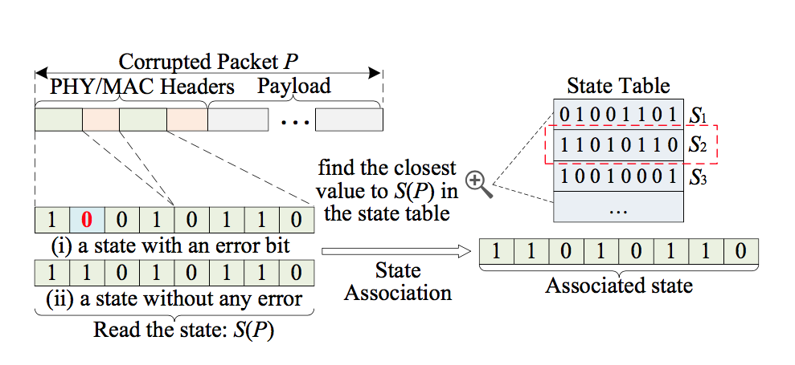
Architecture: State Association

Slide 25
Architecture: Signal Re-processing
Signal Re-processing uses Ŝ(P) to create an extended preamble for P to improve channel and frequency estimations
P is then decoded again using new estimations
Two steps:
Form extended preamble
Extended preamble x_{L} = [x m(Ŝ(P))]
x is original preamble, m(Ŝ(P)) is Ŝ(P) re-modulated
Re-estimate and re-decode

Slide 26
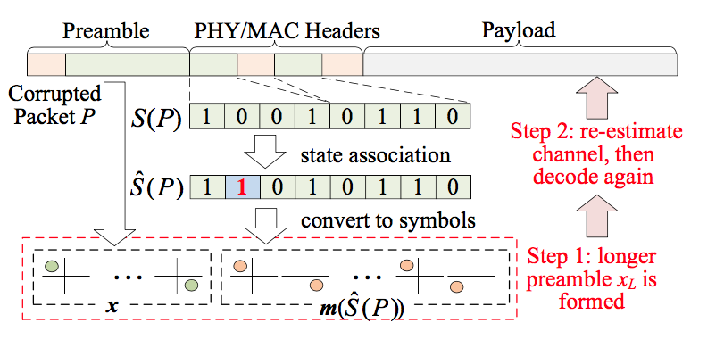
Architecture: Signal Re-processing

Slide 27
Experimental Evaluation
The team mentioned in Contributors implemented STAPLE in various standards
802.11b/g/n/ac
802.15.4
Implemented using multiple USRP X300 SDR
OctoClock-G was used to synchronize the SDR’s for MIMO functionality

Slide 28
Experimental Evaluation
Constants implemented:
Threshold = 12
Station Table Size = 5
AP Table Size = 15
Performance gain ratio = (PDR with STAPLE / PDR with traditional design) - 1

Slide 29
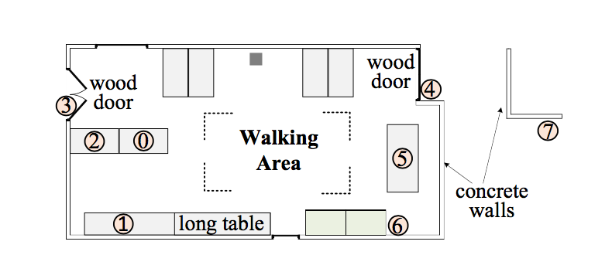
Experimental Evaluation

Slide 30
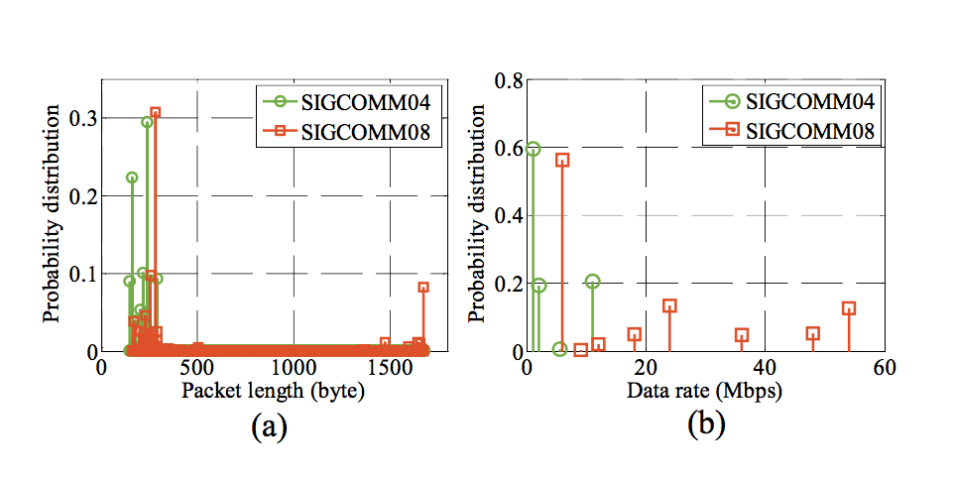
Experimental Evaluation

Slide 31
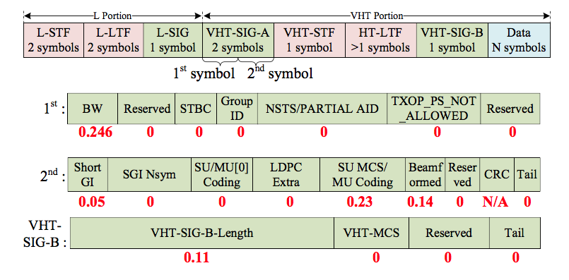
Experimental Evaluation: 802.11ac
S(P) = L-SIG | VHT-SIG | VHT-SIG-B

Slide 32
Experimental Evaluation: 802.11ac
Two scenarios implemented:
Single-link
A single 2-antenna transmitter sends packets to a receiver with 2-8 antennas
Network
Two synchronized USRPs are implemented to act as a single 802.11ac AP
Six USRPs each act as a station

Slide 33
Experimental Evaluation: 802.11ac Single-Link
Single-Link Evaluation
Varying Locations
Varying Packet Lengths
Varying Numbers of Antennas

Slide 34
Experimental Evaluation: 802.11ac Single-Link
Varying Locations
Transmitter and Receiver both have 2 antennas
Transmitter at Location 1
Receiver location varied between:
Location 0: S-LoS (short-distance line-of-sight)
Location 3: S-NLoS
Location 4: L-LoS
Location 5: L-NLoS

Slide 35
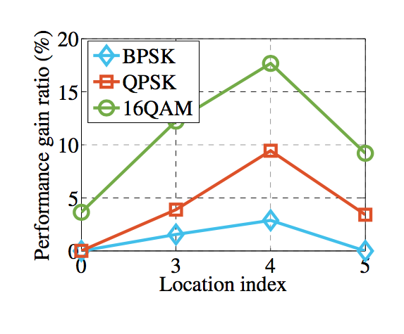
Experimental Evaluation: 802.11ac Single-Link
Uniform performance boosts for most locations and modulation schemes. Greater boost from NLoS.
Location 0 and 5 BPSK had 100% PDR
STAPLE provides higher performance boost for higher data rates (16QAM), demands more accurate estimation

Slide 36
Experimental Evaluation 802.11ac Single-Link
Varying Packet Lengths
2x4 MIMO link
2 transmitting antennas, 4 receiving antennas
Transmitter at Location 1
Receiver at Location 5
Packet length varied from 10-1500
 | 10 | 100 | 500 | 1000 | 1500
Traditional | 99.9% | 99.9% | 98.3% | 93.5% | 91.5%
STAPLE | 100% | 100% | 99.9% | 99.7% | 98.3%

Slide 37
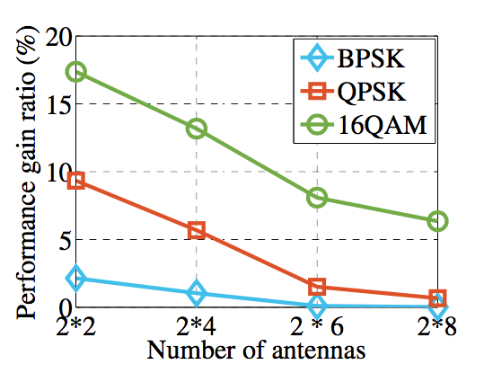
Experimental Evaluation: 802.11ac Single-Link
Varying Numbers of Antennas
Transmitter at Location 1
Receiver at Location 5
Varied MIMO configurations:
2x2
2x4
2x6
2x8

Slide 38
Experimental Evaluation: 802.11ac Single-Link
Receiver moved to Location 7 (L-NLoS)
Beyond limit of 2x4 for QPSK and 16QAM
Beyond limit of 2x6 for 16QAM
 | BPSK | QPSK | 16QAM
2x4 | 20.2% | N/A | N/A
2x6 | 16.6% | 20.4% | N/A
2x8 | 11.4% | 18.9% | 20.8%

Slide 39
Experimental Evaluation: Network
Network Performance Evaluation
AP has 4 antennas
Location 0
Stations have 2 antennas
Location 1-6
Named Node 1-6 respectively

Slide 40
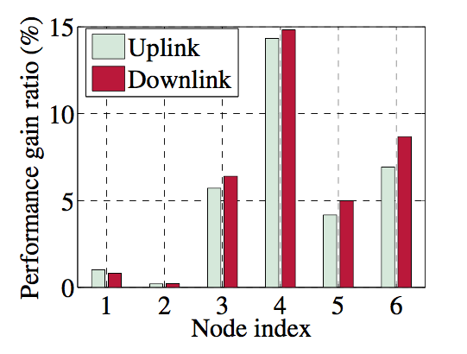
Experimental Evaluation: Network
Overall Performance

Slide 41
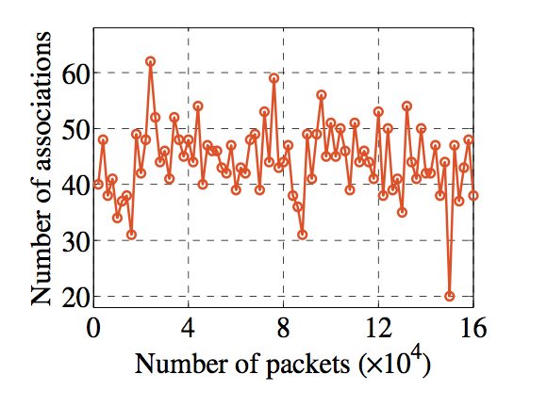
Experimental Evaluation: Network
Overall Performance

Slide 42
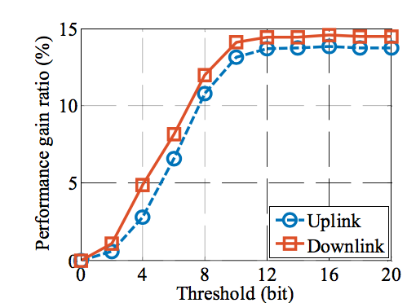
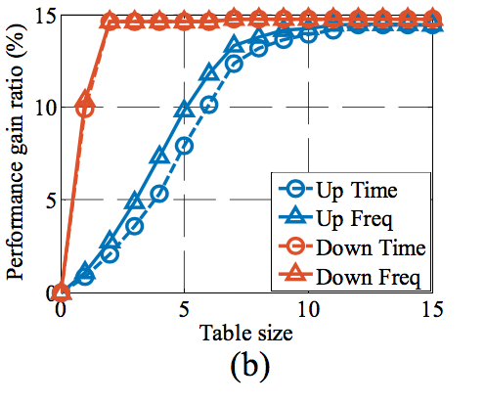
Experimental Evaluation: Network
Impacts of Threshold and Table Size
Changes made to Node 4
Too large of threshold results in false associations
Table management policies exhibit similar performance with slight uplink performance from frequency policy

Slide 43
Conclusions
STAPLE can be implemented in wireless packet reception systems without additional hardware or serious modifications to processing and decoding
Simply modifies and re-processes packets which would be dropped due to decoding errors
Can be implemented in most wireless standards (802.11, 802.15.4, BLE, etc.)
Has low overhead requiring only a small table (2-20 entries) and minor additional software to handle state association and signal re-processing
Up to 20.8% performance increase

Slide 44
All images and definitions used were obtained from the paper under discussion

