Slide 1
Intercepting Mobile Communications: The Insecurity of 802.11
Nikita Borisov, Ian Goldberg, David Wagner, in Proc. of
ACM Mobicom 2001.
-Shuli He

Slide 2
WEP Protocol
WEP – Wired Equivalent Privacy
Wireless networks standard 802.11
Designed to provide the same level of security as wired networks
Protocol goals:
Confidentiality: prevent eavesdropping
Access control: protect access to a wireless network infrastructure
Data integrity: prevent tampering with messages
None of the security goals are achieved.

Slide 3
Confidentiality
If C1 = P1 ⊕ RC4(v,k); C2 = P2 ⊕ RC4(v,k) Then C1 ⊕ C2 = P1 ⊕ P2
Risks of keystream reuse
If plaintext of one of the message is known, the other is immediately obtainable.
There are known techniques for breaking reused keystreams.
Two conditions required for this class of attacks to succeed:
Availability of ciphertexts where the keystream is used more than once.
Partial knowledge of some of the plaintexts.

Slide 4
Finding instances of keystream reuse
Shared key k changes rarely.
Reuse of IV’s reuse of the RC4 keystream
IV’s are public

Slide 5
IV(initialization vector) issue
WEP standard recommends (but does not require) that the IV be changed after every packet.
PCMCIA cards sets IV to zero and increment it by 1 for each packet.
The IV field used by WEP is only 24bits.
Birthday paradox: Random IV for each packet will be expected to incur collisions after transmitting just 5000 packets.

Slide 6
Exploiting keystream reuse
Many fields of IP traffic are predictable.
login sequences
shared library
Active attack
sending IP traffic directly
sending spam e-mail
Attacker
encrypted
Attacker

Slide 7
Decryption Dictionaries
Build dictionaries from the intercepted messages
Full table roughly 24 GB
Dictionary attack is effective regardless of key size
Worse: PCMCIA cards reset the IV to 0 for each reinitialization.

Slide 8
Key Management
Use a single key for an entire network
The keys stored on the users’ computers
Increases chances of IV collision

Slide 9
Message Authentication
Message Modification (Data integrity)
Message Injection (Access control)

Slide 10
Message Modification
WEP uses an integrity checksum field.
CRC-32 checksum is a linear function of the message.
Means that checksum distributes over the XOR operation.
C(x ⊕ y) = C(x) ⊕ C(y)
RC4 stream cipher is also linear.

Slide 11
C -> C’
Cipher
Δ
CRC(Δ)
RC4(v, k)
Message
CRC(M)
Δ
CRC(Δ)
Δ
CRC(Δ)
RC4(v, k)
Message
CRC(M)
RC4(v, k)
Message’
CRC(M’)

Slide 12
C -> C’
C’ = C ⊕ (△ ,C(△ )) = RC4(v, k) ⊕ (M, c(M)) ⊕ (△ ,C(△ )) = RC4(v, k) ⊕ (M ⊕ △ , C(M) ⊕ C(△ )) = RC4(v, k) ⊕ (M’, C(M ⊕ △ ) = RC4(v, k) ⊕ (M’, C(M’))
*c(M) ⊕ c(△ )= c(M ⊕ △ )

Slide 13
Message Injection
WEP checksum is an unkeyed function of the message.
If the attacker learns the complete plaintext of any given ciphertext packet, he can recover keystream to encrypt the packet:
P ⊕ C= P ⊕ (P ⊕ RC4(v，k))= RC4(v，k)
C’ = (M’, c(M’)) ⊕ RC4(v， k)
Reuse old IV values without triggering any alarms at the receiver.

Slide 14
Authentication Spoofing
Before forming an association, access points will authenticate the mobile stations.
Send a 128-byte random string challenge.
Respond with the same challenge encrypted using WEP.
response
Attacker
challenge
plaintext
ciphertext

Slide 15
Message Decryption
Trick the access point into decrypting some ciphertext for us
IP redirection
Reaction attacks

Slide 16
IP redirection
modify

Slide 17
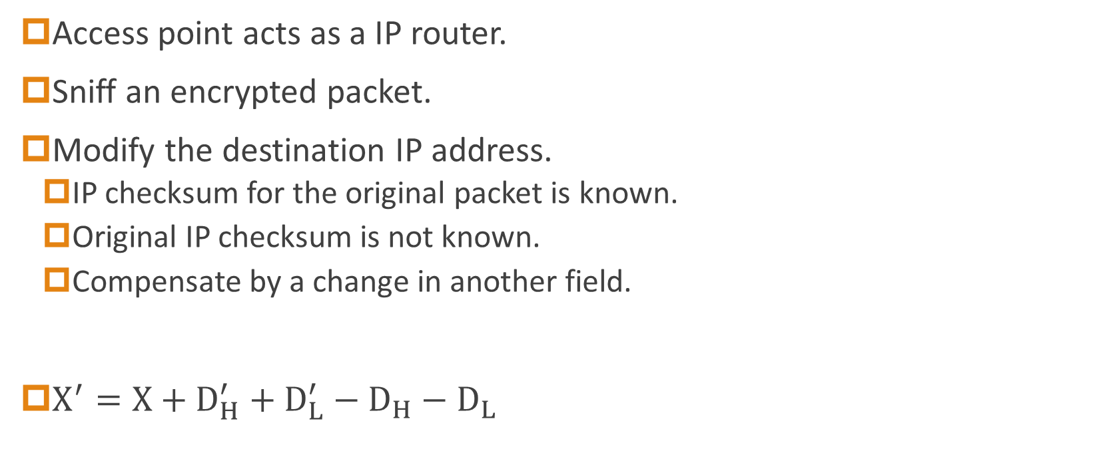
IP redirection
Access point acts as a IP router.
Sniff an encrypted packet.
Modify the destination IP address.
IP checksum for the original packet is known.
Original IP checksum is not known.
Compensate by a change in another field.
$X^{′}=X+D_{H}^{′}+D_{L}^{′}−D_{H}−D_{L}$
high 16-bit
low 16-bit

Slide 18

IP checksum is not known
$X^{′}=X+D_{H}^{′}+D_{L}^{′}−D_{H}−D_{L}$
Given ξ = X’ – X
Need △＝ X ⊕ X’
By the value of ξ to guess the △

Slide 19
X = X’
Modify another field so that X=X’.
Monitoring access to an entire class B network
$D_{L}^{′}=D_{H}+D_{L}−D_{H}^{′}$

Slide 20
Reaction attacks
Only on TCP protocol.
TCP packets will be dropped for incorrect checksum.
TCP return ACK for the correct packets.
Modify packet and check recipients reaction
ACK: $P_{i}$ ⊕ $P_{i+16}$ = 1; No ACK $P_{i}$ ⊕ $P_{i+16}$ = 0
Each ACK will reveal one bit of information.

Slide 21
Countermeasures
Place the wireless network outside of the organization firewall and no routes to the outside Internet exist from the wireless network.
VPN
Improve the key management

Slide 22
802.11i
Replacement of WEP
Defines authentication, key management, confidentiality, integrity and encapsulations for 802.11
Includes
WEP (current implemented)
Encryption: RC4; Integrity: CRC-32
TKIP (temporary solution)
Encryption: RC4; Integrity: Michael
WRAP (Wireless Robust Authenticated Protocol)
Encryption: AES; Integrity: HMAC-MD5

Slide 23
WPA
WPA – Wi-Fi Protected Access
Draft security enhancements for 802.11
A subset of the 802.11i proposed standard
Fixed most of the WEP problems
Design goals
Preserve packet format
Work with deployed 802.11 hardware in AP and NICs
Composed of two components
Authentication and master key generation– 802.1X
TKIP (Temporal Key Integrity Protocol) - Temporal key generation, Confidentiality and Integrity

Slide 24
TKIP
TKIP - Temporal Key Integrity Protocol
A cryptographic 64 bits MIC (Message Integrity Code)
A per-packet sequence number
A per-packet key mixing function
Key regenerated frequently

Slide 25
TKIP
Use RC4 as its cipher
Provide a rekeying mechanism
Every data packet is sent with a unique encryption key

Slide 26
WPA Insecurity
MIC and key mixing algorithms are cryptographically weak.
WPA2 replaced WPA
CCMP(Counter Mode CBC-MAC Protocol) an AES(Advanced Encryption Standard)-based encryption mode.
KRACK(Key Reinstallation Attack)
Don’t need the key
Aims at four-way handshake to by deceiving the user to reset the used key.
WPA2 don’t require the key can be used once.
WPA3
Uses 192-bit encryption and individualized encryption for each user.

Slide 27
Conclusion
Design of security protocols is difficult (more than the design of network protocols).
Combining several secure algorithms does not mean that the result is secure.
Engineering perspective dictated selection of cryptographic algorithms.

