Slide 1
Widar: Decimeter-Level Passive Tracking via Velocity Monitoring with Commodity Wi-Fi
Contributors: Kun Qian, Chenshu Wu, Zheng Yang, Yunhao Liu, Kyle Jamieson
ACM MobiHoc, Chennai, India, July 10-14, 2017
- Zixuan Zhao

Slide 2
Outline
Introduction
Preliminary
Modeling of CSI-Mobility
PLCR Extraction
Tracking velocity & location
Evaluation
Conclusion

Slide 3
Human mobility tracking
Location awareness: a key enabler for a wide range of applications such as smart homes, virtual reality, augmented reality, security monitoring, and asset management.
Traditional approaches to track human mobility:
1)smartphones or wearable sensor devices attached to users;
2)work passively with infrastructure installed in the area: cameras, wireless sensor Networks (WSNs)

Slide 4
Existing innovative approach
Recent innovation in wireless communication: Passive human sensing with Wi-Fi signals, such as WiVi, E-eyes, CARM for human detection, activity classification, gesture recognition(RF based approaches)
Limitations of existing works:
Cannot track fine-grained human mobility information (speed, direction and location).
Do not quantitatively model the relationships between signal features and human mobility. Outputs locations directly from radio signals.
Statistical learning techniques by seeking appropriate statistical features of Wi-Fi signals—only recognize pre-defined gestures and activities, require prior training.

Slide 5
Widar, a Wi-Fi-based tracking system
Device-free, passive tracking
Simultaneously estimates a human’s moving velocity (speed and direction) and location at a decimeter level.
Emulate a Wi-Fi-based velocimeter that measures the instantaneous velocity (both speed and direction), in order to track fine-grained continuous locations.

Slide 6
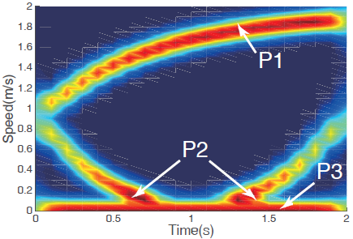
Widar, a Wi-Fi-based tracking system
1. Build a geometrical model that captures the relationships of CSI dynamics and human mobility, without prior training requirement.
Key observation: movement at different locations with different velocities induces different changes in the lengths of individual signal propagation paths.
Extract the rate of change of each signal propagation path length (path length change rate, PLCR) to derive velocities and locations directly from the Channel State Information(CSI) of Wi-Fi signals

Slide 7
Widar, a Wi-Fi-based tracking system
2. Design a complete system that simultaneously and directly tracks human moving velocity (both speed and direction) and location.
In particular, Widar can directly estimate the velocity of human motion.
3. Implement Widar and validate its performance on COTS(commercial off-the-shelf) Wi-Fi devices.

Slide 8
Challenges and solutions
1. Derive moving velocity from the PLCR: a huge gap exists between CSI and velocity
Use a quantitative model.
2. Determine signs of PLCRs which indicate moving direction.
Use a novel error function.
3. Identify moving velocity from the superpositioned reflections from different human body parts.
Propose a novel PLCR extraction algorithm based on dynamic programming to identify the targeted frequency components.

Slide 9
Channel State Information
In wireless communications, channel state information (CSI) refers to known channel properties of a communication link. This information describes how a signal propagates from the transmitter to the receiver and represents the combined effect of, for example, scattering, fading, and power decay with distance.
The wireless channel has the following structure at frequency f and time t :
K is the total number of multipath components. αk (t ) and τk (t ) are the complex attenuation factor and propagation delay for the k-th path respectively.
CSI is a discretely sampled version of channel response in time-frequency space.

Slide 10
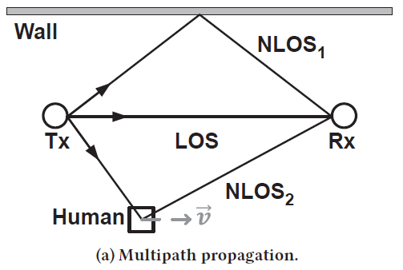
From CSI to PLCR
Relative movements between transceivers and reflectors lead to Doppler effect
Root cause: change in the length of signal propagation path
The frequency shift of the signals reflected off the moving human is :
λ, f , τ (t ) are the wave-length, carrier frequency and time of
flight of the signal, and d(t ) is the length of the path NLOS2.
PLCR r is mathematically defined as

Slide 11
From CSI to PLCR
CSI can be represented as superimposition of path responses modulated by Doppler frequency shift arising from moving reflectors on each path:
Hs (f ) is the sum of responses for static paths (fD = 0), Pd is the set of dynamic paths.
However, CSI is polluted by unknown phase shifts κ(f , t ).

Slide 12
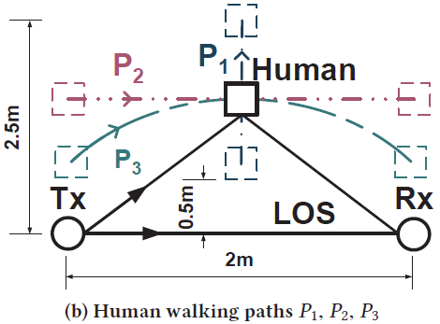
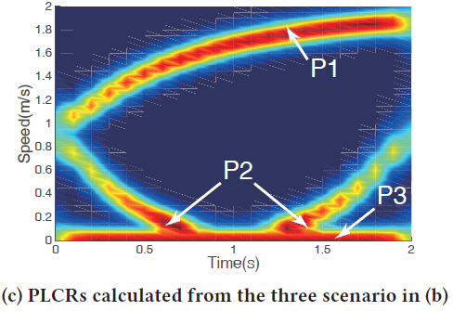
Challenges for Tracking
PLCR only reflects the Doppler frequency shift. It is not real velocity of the moving target. Instead, both target velocity and location jointly determine the PLCR of the target reflecting path.
target P1 is on the perpendicular bisector of the link;
P2 is parallel with the link; P3 is on an ellipse whose foci are the transmitter and receiver.
Need a more advanced model.

Slide 13
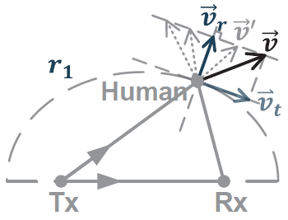
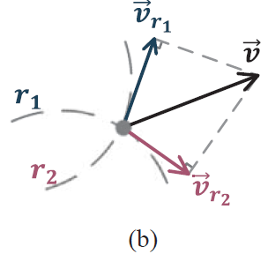
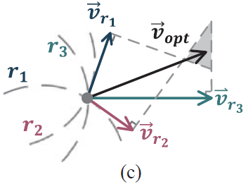
Modeling of CSI-Mobility
Consider the geometrical constraints between reflection paths and human movement.
The Ideal Model(the model with information of the sign of PLCR): When a target moves, only certain velocity components affect reflecting path lengths, and thus influence the corresponding PLCR.
Only radial velocity can be deduced from PLCR, and target velocity cannot be uniquely identified.
(a)Target velocity cannot be uniquely identified
Derive the true velocity with more links
Three links

Slide 14
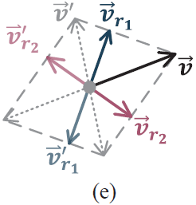
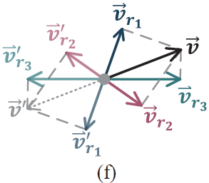
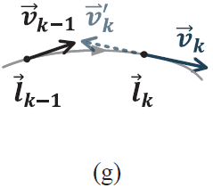
The Real Model (without the sign information)
(d)one link (e)two links (f)three links
(g) Consecutiveness of target movements
The directions of consecutive velocities within a certain small time interval (e.g. 100ms), are likely to be similar.
Design an effective model to derive continuous velocities of human movements from PLCRs extracted from CSI measurements

Slide 15
PLCR Extraction
CSI Preprocessing:
Passband filtering: adopt a Butterworth filter and apply filters to all subcarriers of CSI power series to eliminate independent noises and interference in each subcarrier.
Subcarrier selection
Time-frequency Analysis: the non-overlapping spectrograms of all segments are spliced together to generate the whole PLCR spectrogram.

Slide 16
PLCR Extraction Algorithm
Significant errors- because the spectrogram may contain abnormal fluctuations due to remnant noises and interferences.
An extraction algorithm based on the acceleration constraints of path length change.
The acceleration a and Doppler frequency shift fD has following relation:
We can decimate the spectrogram in time domain to limit the frequency change in adjacent time samples to a single frequency bin.

Slide 17
PLCR Extraction Algorithm
The optimal PLCR can be solved by the dynamic programming problem and apply a moving average window to the series to further smooth the data:
Denote the spectrogram as WT ×F , where F is number of frequency bins and T is number of time bins.

Slide 18
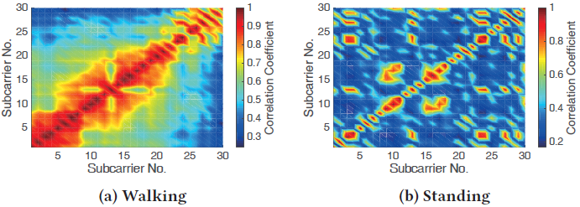
Tracking velocity & location
Movement Detection
Two key observations:
The correlation between different subcarriers increases when human walking;
when a human is walking, the spectrogram power concentrates at certain frequencies corresponding to the signal reflected by the human body.
Widar calculates the mean cross correlation value C and mean normalized variance σ^2 of power distribution of frequency spectrum.
The movement detection indicator(MDI) is then defined as
Only when MDI exceeds the predefined location-independent threshold, Widar starts to track human movement.

Slide 19
Tracking velocity & location
2. Initial Location Estimation: a quick-and–dirty location search
First, Widar search through the whole tracking area at a coarse resolution, identifying a location that yields the least fitting error of the trace, as the initial location.
Second, search through the narrowed area around the initial location at a fine-grained resolution to refine the initial location accuracy.
This search step can be iterated until the fitting error achieves the minimum.
3. Successive Tracking
The target location:

Slide 20
Trace Refinement
A pseudo self-calibration scheme:
Perform trace segmentation at these vulnerable moments and re-initialize the tracking process for each new segment to guarantee the correct direction.

Slide 21
Trace Refinement
Antenna selection criterion:
Some links yield wrong PLCRs due to weak reflecting signal-to-noise ratio and small PLCR itself, which may lead to totally wrong trace.
To pick out these “bad” antennas, Widar adopts two-round tracking for each trace segment.
First round: least square method to calculate optimal velocity:
Second round: a weight is applied to suppress “bad” antennas:
W = diag(w(1)w(2) · · ·w(L)) is the weight matrix, w(i) is the weight for the i-th link.

Slide 22
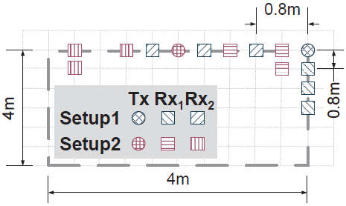
Evaluation
Implementation: one transmitter, two receivers
Design traces with various lengths, directions and shapes (such as line, curve, rectangular, circle and fold line, etc.). Test them with 5 volunteers.
Deployment schemes of Widar:
Setup 1: devices at the corner
Setup 2: devices at one side

Slide 23
Evaluation
The visual tracking algorithm:
Identifies the tracking target in the video frame;
Transforms the pixel coordinates of the target to the world coordinates in physical space.
Velocity and location errors are calculated in a point-to-point manner.
Obtaining ground truth via visual videos

Slide 24
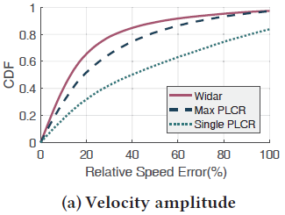
Overall Performance
Performance in Velocity Tracking
For speed, we compare Widar with:
a simple method: Max PLCR --the largest PLCR among all links as its estimate of target speed;
only one link is available (Single PLCR).
Widar achieves the highest accuracy with a median error of 13%, while those of Max PLCR and Single PLCR are 19% and 40% respectively.
The CDF of relative speed errors of three methods over all
trajectories.

Slide 25
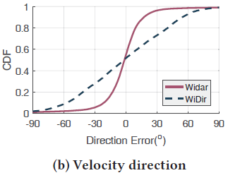
Overall Performance
Performance in Velocity Tracking
For direction, compare Widar with WiDir which essentially calculates PLCR ratio of orthogonal links as target’s moving direction.
Widar achieves an error within 18◦ for more than 80% measurements, while WiDir achieves only an error of 55◦

Slide 26
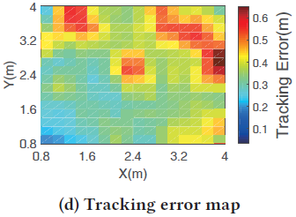
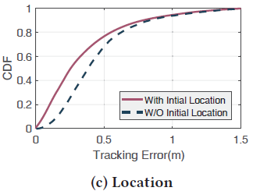
Overall Performance
Performance in Location Tracking: guarantee decimeter-level accuracy
With accurate initial location, Widar achieves high tracking accuracy with a median tracking error of 25 cm.
Without initial location, the performance slightly degrades yet the median tracking error is still as low as 38 cm.
Accuracy degrades when the target moves away from the link.

Slide 27
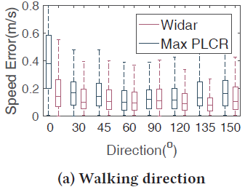
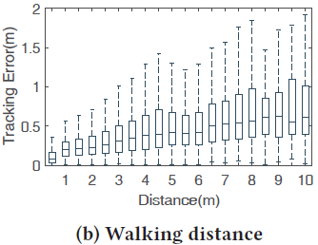
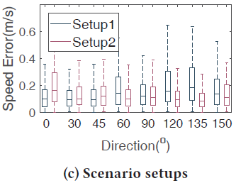
Parameter Study
Impact of walking direction: Widar achieves high accuracy through all walking directions.
Impact of walking distance: the tracking error accumulates at a moderate rate as the target continuously moves. --future work
Impact of deployment: the error distributions with the two deployments are apparently different.

Slide 28
Conclusion
Implement Widar on COTS Wi-Fi devices and evaluate it in real environments.
Widar achieves decimeter-level accuracy with a median location error of 25 cm and 38 cm with and without initial positions and a median relative velocity error of 13%.
Future work focuses on incorporating non-learning based localization and applying Widar to fortify various sensing applications.
https://youtu.be/JSe4bXqH_Ow

