Slide 1
Ns-3 Tutorial
Xin Li

Slide 2
Introduction

Slide 3
What is ns-3?
Network Simulator Version 3
Software simulated models
Discrete-event simulator
Written in C++/Python binding
Focus on packet level
Wired/Wireless

Slide 4
Why ns-3?
Simulation V.S. Testbed
Reproducibility
Ease of deployment
Investigate non-existed systems
Scalability
Ns-3 V.S. other simulation tools
Community-oriented
Free and open-source
Ease of debugging

Slide 5
Setup

Slide 6
Installation
Instructions
https://www.nsnam.org/wiki/Installation
Supported systems
Linux
MacOS
FreeBSD
Windows Linux through virtual machine

Slide 7
Development Environment
IDE
Eclipse
QT Creator
NetBeans
Text editor + command line

Slide 8
Models

Slide 9
The Basic NS-3 Data Flow Model
Application
Application
Application
Application
Sockets-like
API
Protocol
stack
Protocol
stack
Packet(s)‏
Node
Node
NetDevice
NetDevice
NetDevice
Channel
NetDevice
Channel

Slide 10
NS-3 Models: Node & App
Nodes
End-Systems, Routers, Hubs, NATs
Applications
Bulk TCP transfer
TCP/UDP “On-Off” application
Web browsing
Peer-to-peer file transfers
Video streaming
Chat

Slide 11
NS-3 Models: Protocol Stack
TCP-UDP-IPV4-IPV6
Routing Protocols
BGP – OSPF – EIGRP – OLSR – DSR – AODV
Multicast Protocols
PIM-SM/DM - DVMRP

Slide 12
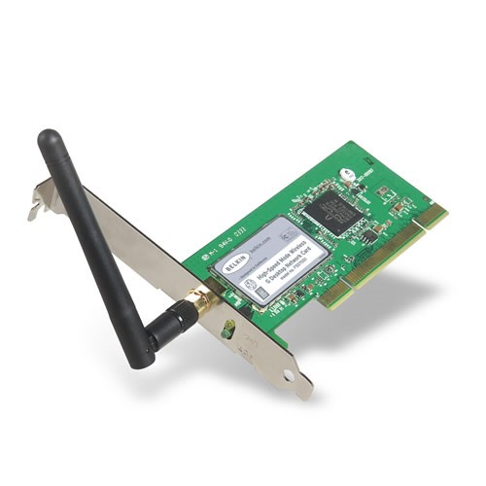
NS-3 Models: Net Device & Channel
Net Devices & Channels bound
WifiChannel
WifiNetDevice

Slide 13
NS-3 Models: Net Device & Channel
Network Interfaces
Wired/Wireless
Layer 2 protocols 802.3, 802.11
Channel
Ethernet (10/100/1000Mb)
Point-to-Point
Wireless
Mobility Models
Random Walk – Specific Waypoint - Swarming

Slide 14
Usage

Slide 15
NS-3 Modules
API: https://www.nsnam.org/doxygen/

Slide 16
NS-3 Build
For those familiar with autotools:
configure -> ./waf -d [optimized|debug] configure
make -> ./waf
make test -> ./waf check (run unit tests)‏
Can run programs through a special waf shell
./waf --run simple-point-to-point

Slide 17
Network Simulation Flowchat
Create topology
Nodes, Links, Queues, Routing, etc.
Create data demand on network
Web browsers, FTP transfers
Run simulation
Analyze results

Slide 18
Smart Pointers
ns-3 objects are memory managed by a reference counting smart pointer implementation
Easier memory management
Treat a smart pointer like a regular pointer

Slide 19
Attributes
Changing objects' characteristics
Member Function
Config System

Slide 20
Random Variables
Currently implemented distributions
Uniform, Poisson Process, etc.
Usage

Slide 21
Callbacks
Allow one piece of code to call a function without any specific inter- module dependency
Example:

Slide 22
Timing and Schedule
Time is not manipulated directly: the Time class
Example:

Slide 23
Logging
ns-3 provides a selectable, multi-level approach to message logging
Logging can be
disabled completely
enabled on a component-by-component basis
enabled globally

Slide 24
Logging
Seven levels of log messages of increasing verbosity:
NS_LOG_ERROR
NS_LOG_WARN
NS_LOG_DEBUG
NS_LOG_INFO NS_LOG_FUNCTION
NS_LOG_LOGIC
NS_LOG_ALL
Each level can be requested singly or cumulatively

Slide 25
Logging
Example:
Enable outside code:

Slide 26
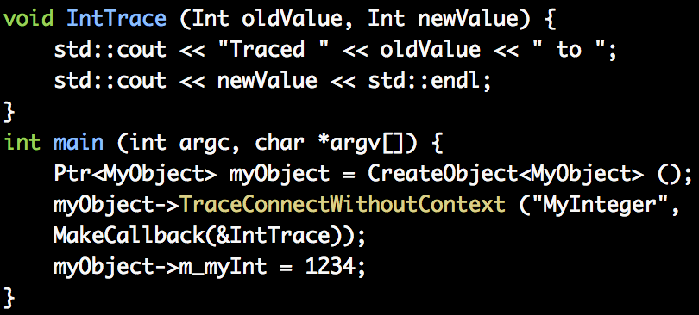
Tracing
Tracing Changes
Producer Consumer Pattern

Slide 27
Tracing
Helper
Connecting source and sink

Slide 28
Visualization
Live visualization with PyViz

Slide 29
Useful Resources
NS-3 Wiki Page
https://www.nsnam.org/wiki/Main_Page
NS-3 Tutorial
https://www.nsnam.org/docs/tutorial/html/
NS-3 API Document
https://www.nsnam.org/docs/release/3.17/doxygen/index.html

